Slide 1

Implementation of a Massive Open Online Course with Google Course Builder and App Engine
Submitted to the SITE Conference 2015
Mokter Hossain
Department of Computer Science
University of Alabama
Tuscaloosa-35401

Slide 2

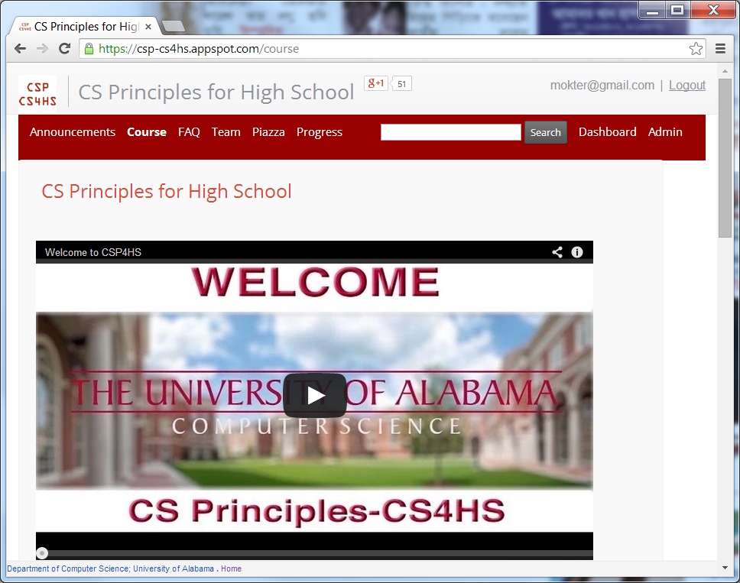
Implementation of a MOOC with Google Course Builder and App Engine
MOOC- Massive Open Online Course
https://csp-cs4hs.appspot.com

Slide 3
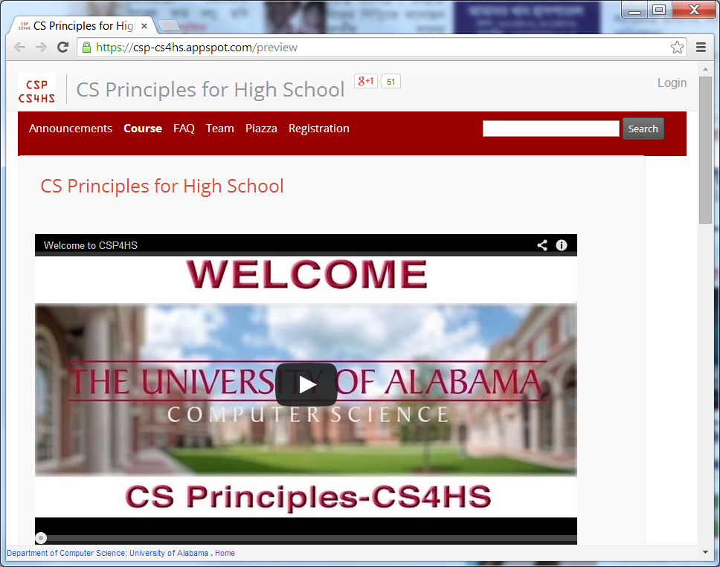
Implementation of a MOOC with Google Course Builder and App Engine
Preview Mode
https://csp-cs4hs.appspot.com/preview

Slide 4
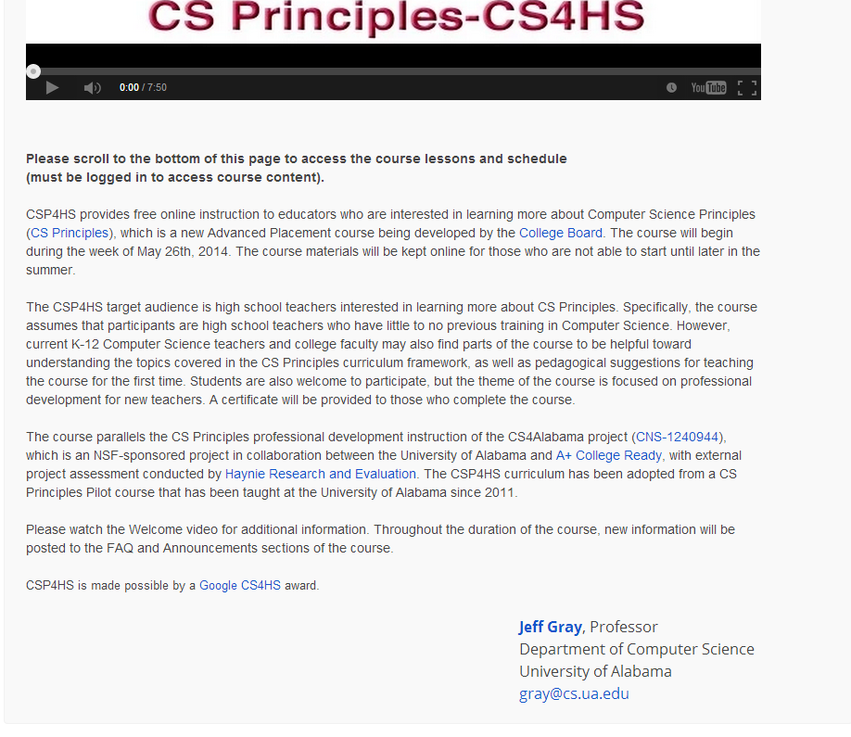
Implementation of a MOOC with Google Course Builder and App Engine
Middle of the Home Page
https://csp-cs4hs.appspot.com

Slide 5
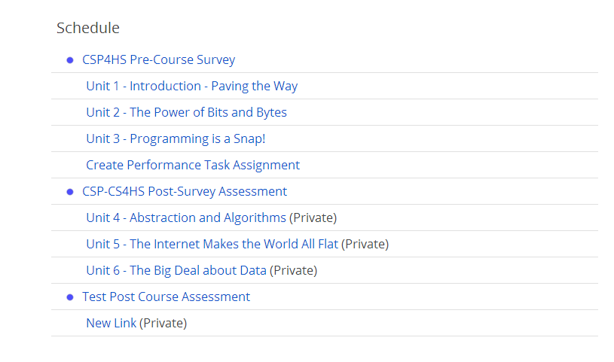
Implementation of a MOOC with Google Course Builder and App Engine
Bottom of the Home Page
https://csp-cs4hs.appspot.com

Slide 6
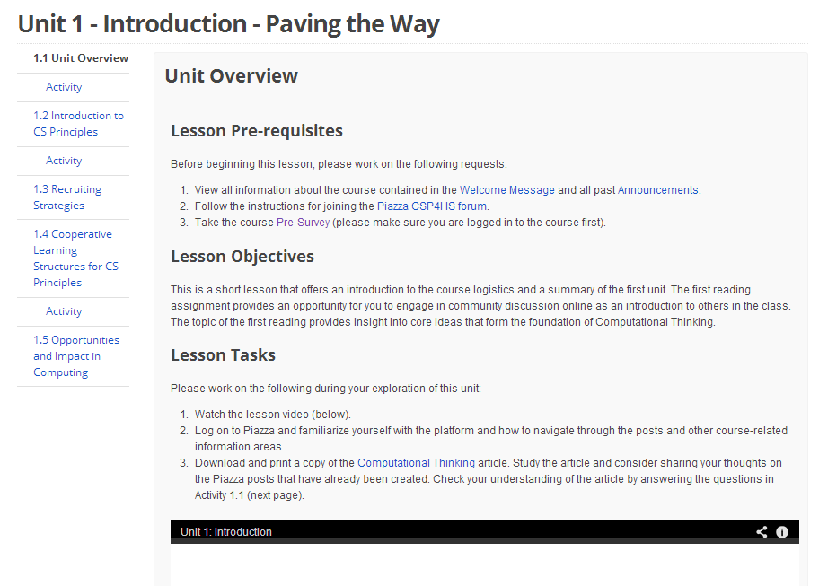
Implementation of a MOOC with Google Course Builder and App Engine
View of an Unit
https://csp-cs4hs.appspot.com/unit?unit=21&lesson=23

Slide 7
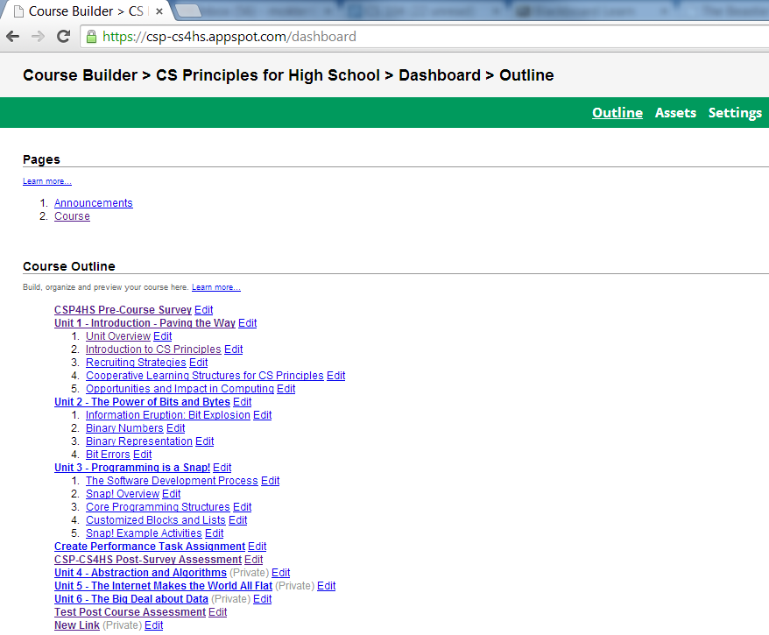
Implementation of a MOOC with Google Course Builder and App Engine
Course Outline

Slide 8
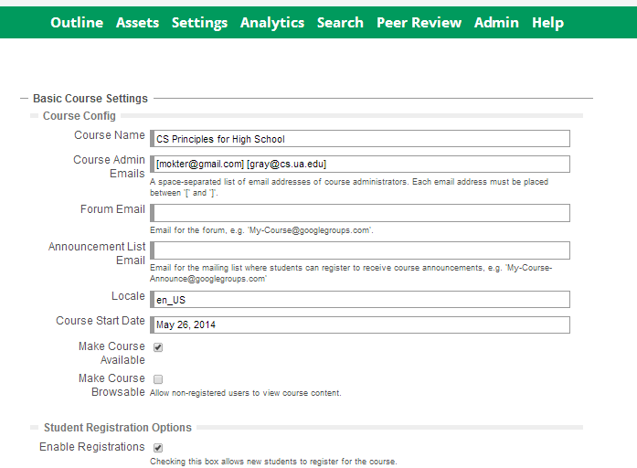
Implementation of a MOOC with Google Course Builder and App Engine
Settings

Slide 9
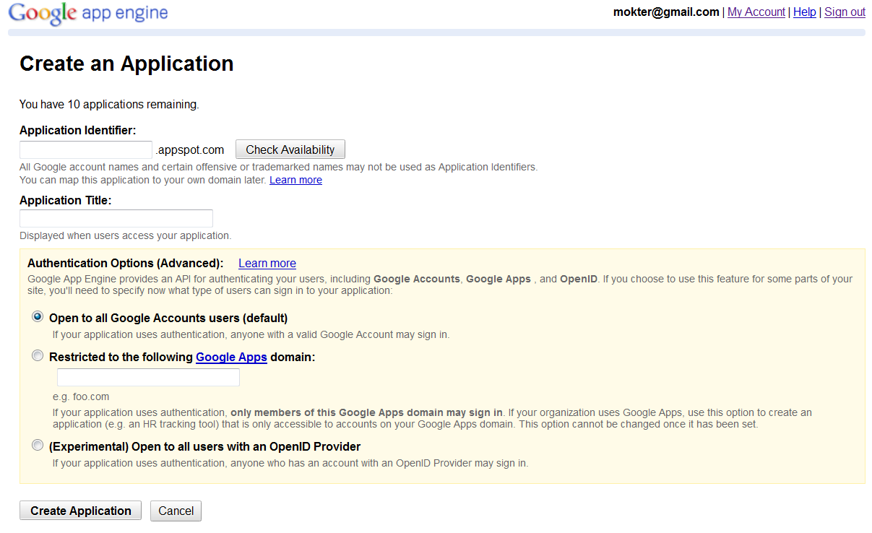
Implementation of a MOOC with Google Course Builder and App Engine
Steps of Implementation
Step-1: Create an Application on GAE at: https://appengine.google.com/start/createapp

Slide 10
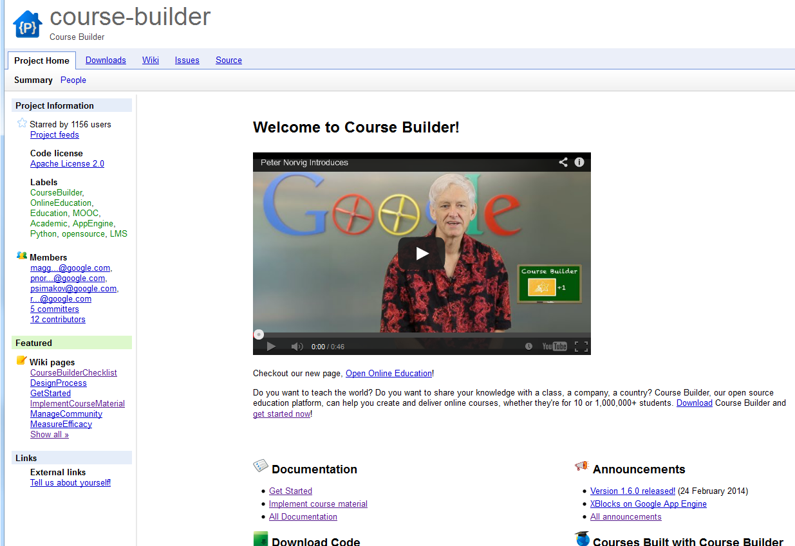
Implementation of a MOOC with Google Course Builder and App Engine
Steps of Implementation
Step-2: Go to the Google Course Builder Home page at: https://code.google.com/p/course-builder/

Slide 11
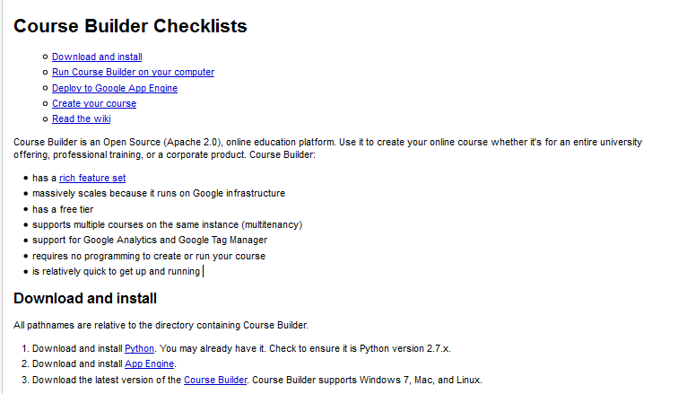
Implementation of a MOOC with Google Course Builder and App Engine
Steps of Implementation
Step-3: Click on the Get Started Link (Located under Documentation and follow the steps:

Slide 12
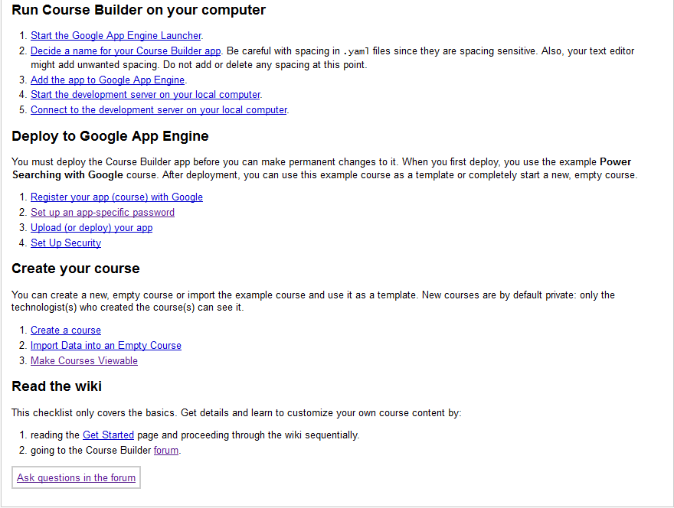
Implementation of a MOOC with Google Course Builder and App Engine
Steps of Implementation
Step-4: Click on the Get Started Link (Located under Documentation and follow the steps:

Slide 13
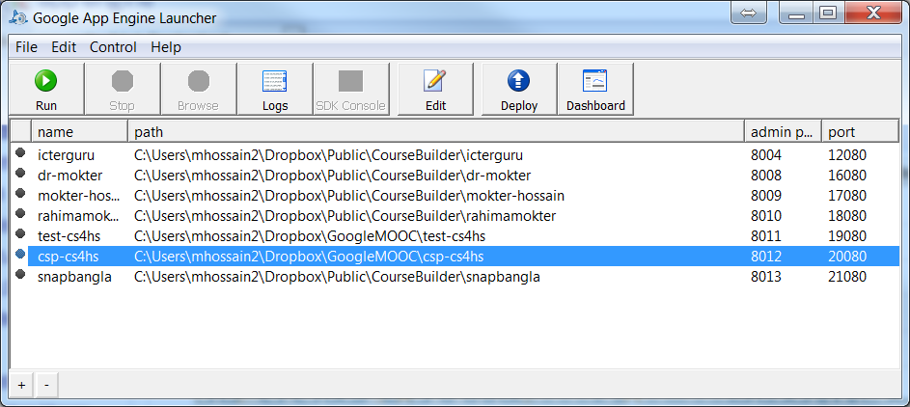
Implementation of a MOOC with Google Course Builder and App Engine
Deployment with Google App Engine Launcher

Slide 14
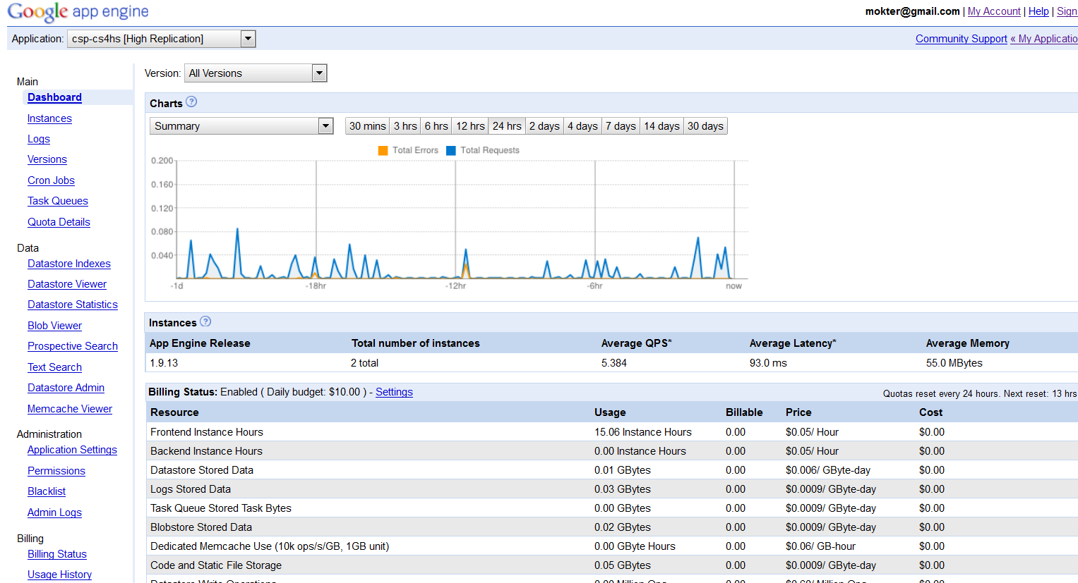
Implementation of a MOOC with Google Course Builder and App Engine
Google App Engine Dashboard
https://appengine.google.com/dashboard

Slide 15
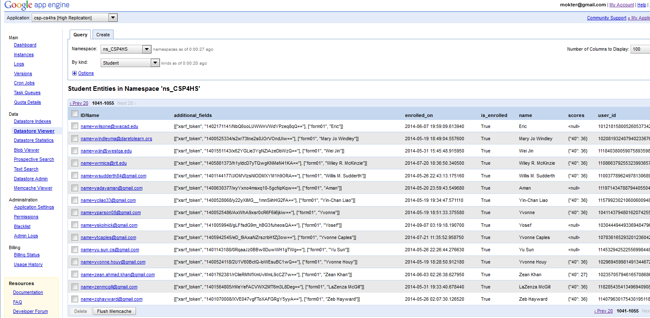
Implementation of a MOOC with Google Course Builder and App Engine
Google App Engine Datastore Viewer

Slide 16
Implementation of a MOOC with Google Course Builder and App Engine
Downloading Course Data from Google App Engine
The hardest part of the entire process!!
Resources:
https://code.google.com/p/course-builder/
https://cloud.google.com/appengine/docs

Slide 17


Implementation of a MOOC with Google Course Builder and App Engine
Thank You

